Slide 1
Weather Patterns in Brazil
Theme of project
Coding approach
Data munging techniques

Slide 2
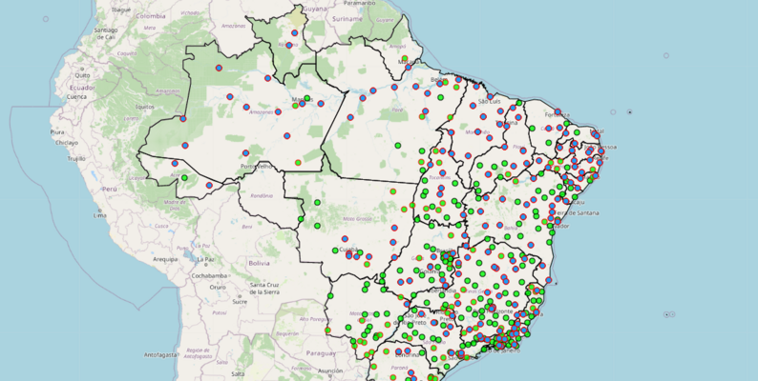
Theme Choice
We chose weather data in Brazil due to availability, data quality and the potential to compare different regions for a holiday
Opening question: Where is the best place for weather during a holiday in Brazil, can we compare regions?
Hourly Climate data from 122 weathes stations between 2000 and 2021
Source: INMET (National Meteorological Institute - Brazil). https://www.kaggle.com/datasets/PROPPG-PPG/hourly-weather-surface-brazil-southeast-region

Slide 3
Coding Approach Overview
Step 0: Selected a database type for our csv file (include the reason)
Step 1: inspect the data and understand what kinds of analysis could be done and any limitations
Step 2: Considered the database and changed columns names to match the SQL code. Each of the team members chose a csv to clean and inspect. We discussed the data limitations of Hiroku and chose an appropriate time of day to analysis
Step 3: Create/choose a shell for the website and decide on the information we would display and use.
Step 4: Construct the charts and maps using d3.

Slide 4
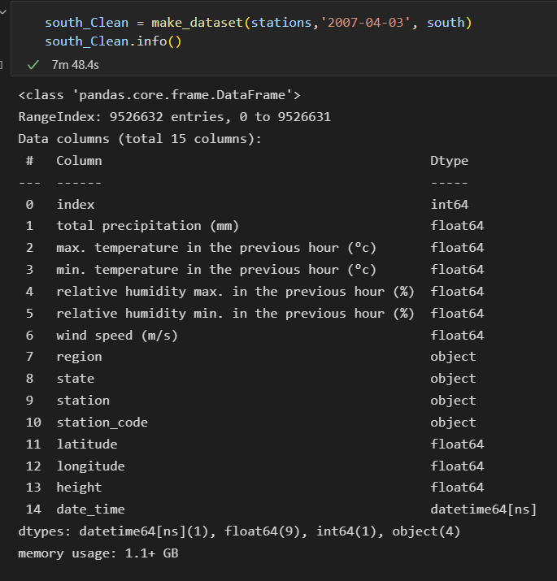
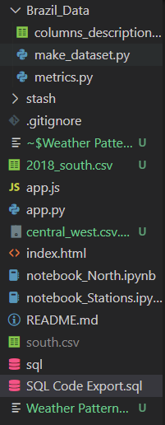
Data Munging
What came with this raw data?- there was 100,000 of rows to clean because we had hourly data. For the purpose of the project we only needed daily data during the middle of the day.
We read the csv using pandas, Reset columns and get relevant info, removed NA data such as -9999
Our function did not work properly for removing the -9999 in the data so we removed these columns

Slide 5
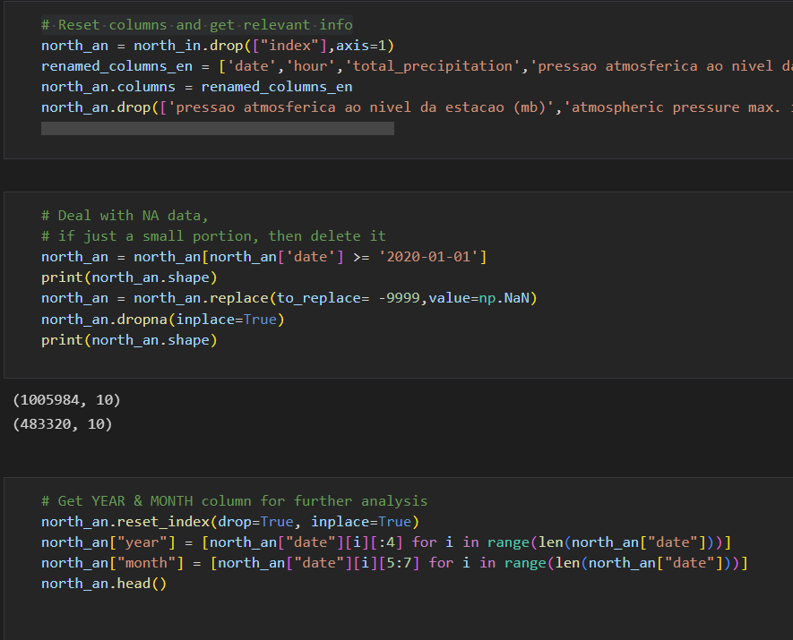
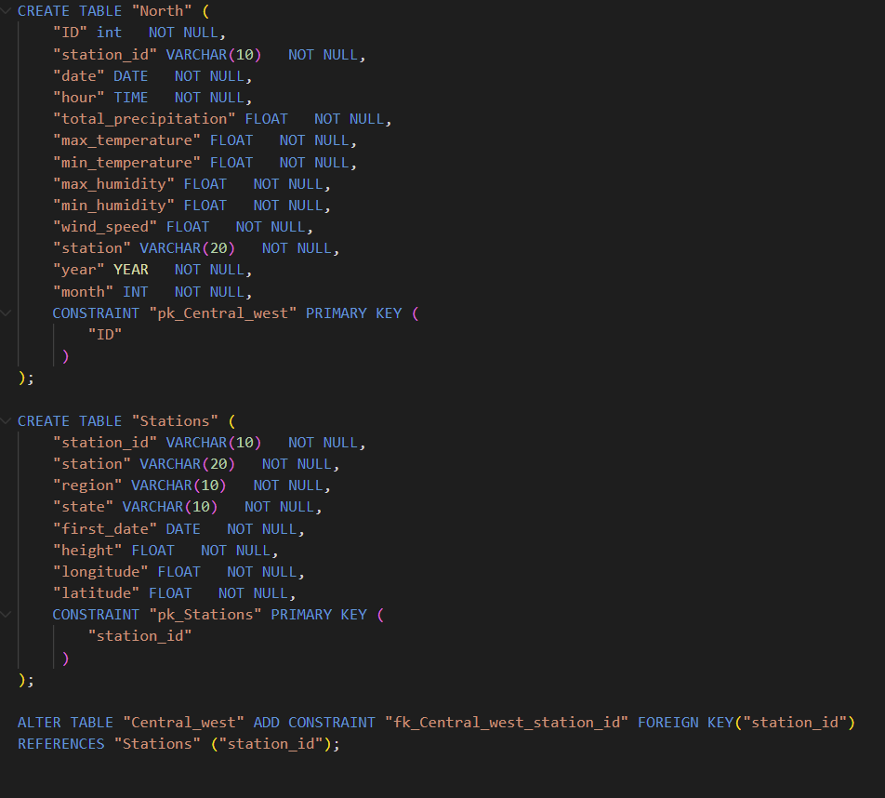
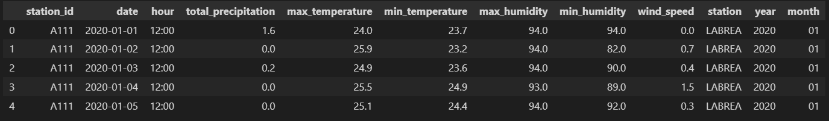
Cleaning the raw data
Rename and drop columns, drop NA rows, filter by date, adding ‘month’ and ‘year’ columns, dropping all rows not at 12pm
The SQL code
Final dataframe

Slide 6
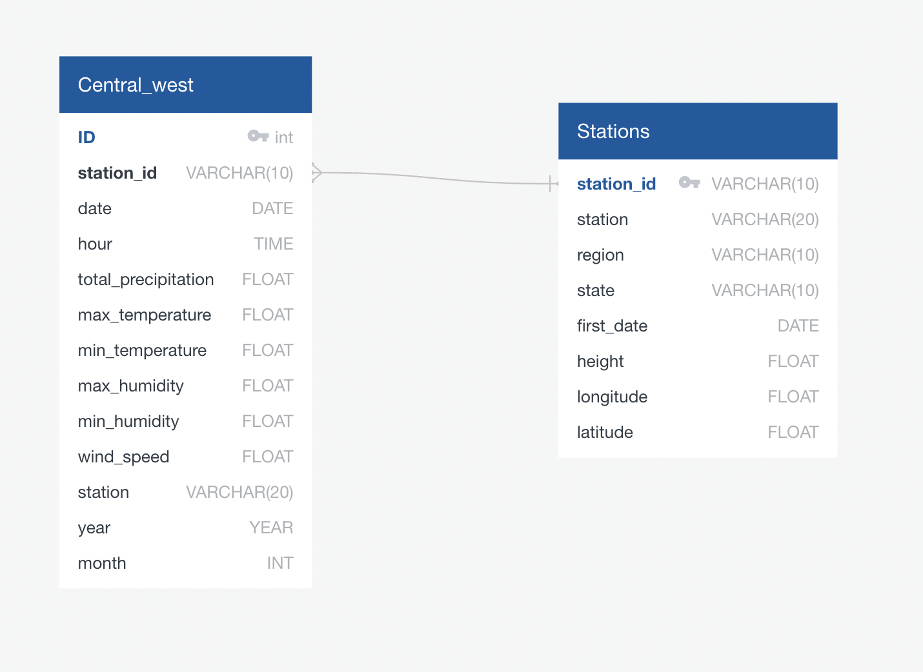
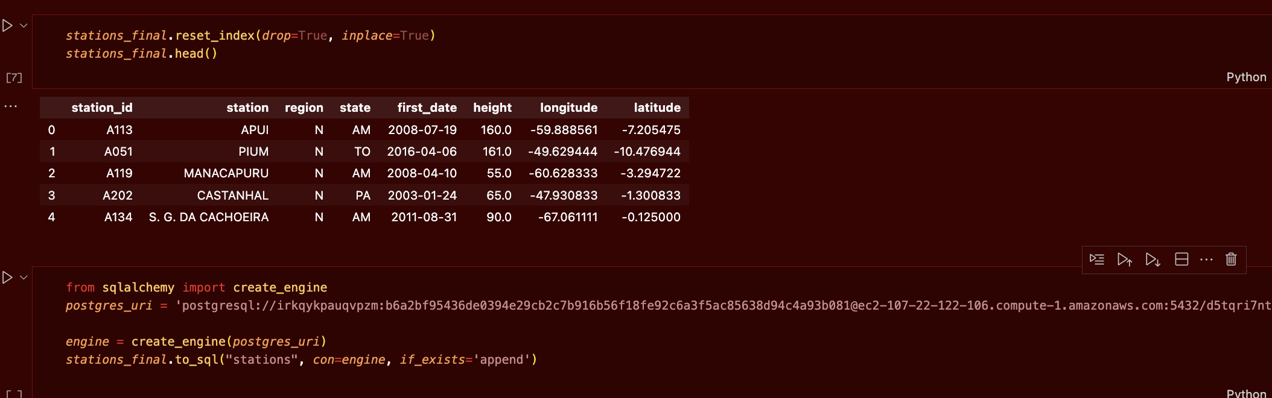
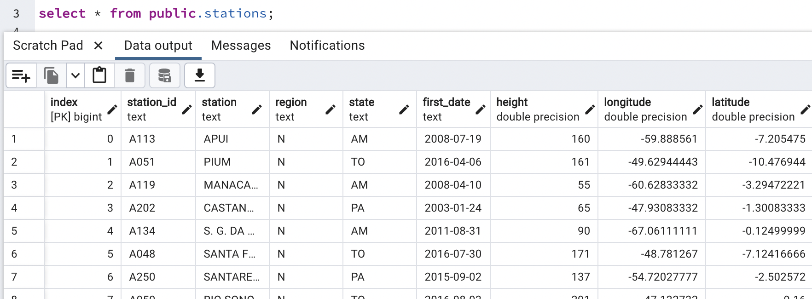
Creating Database
ERD
Pushing tables to postgres
North: 5595 rows
Stations: 24 rows

Slide 7
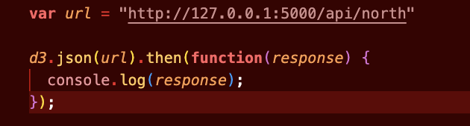
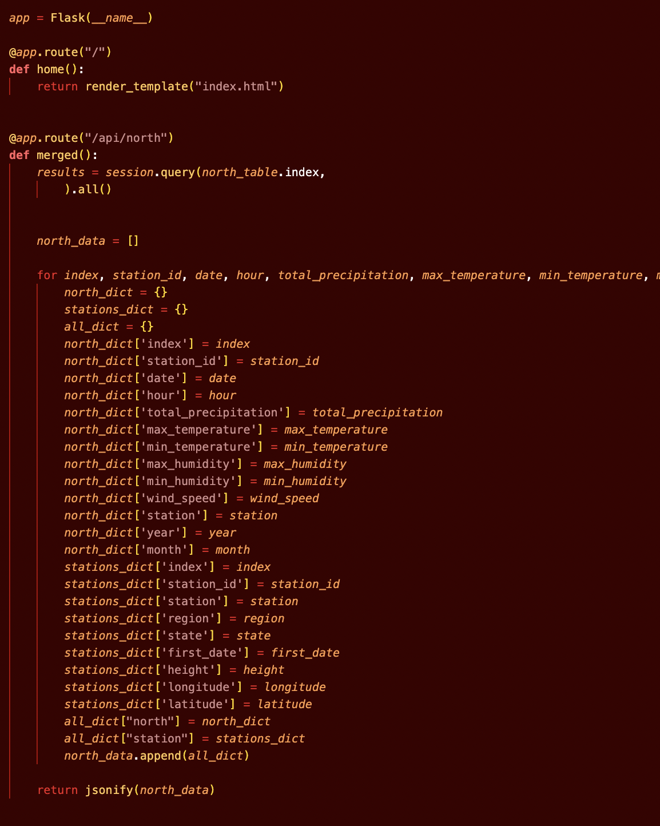
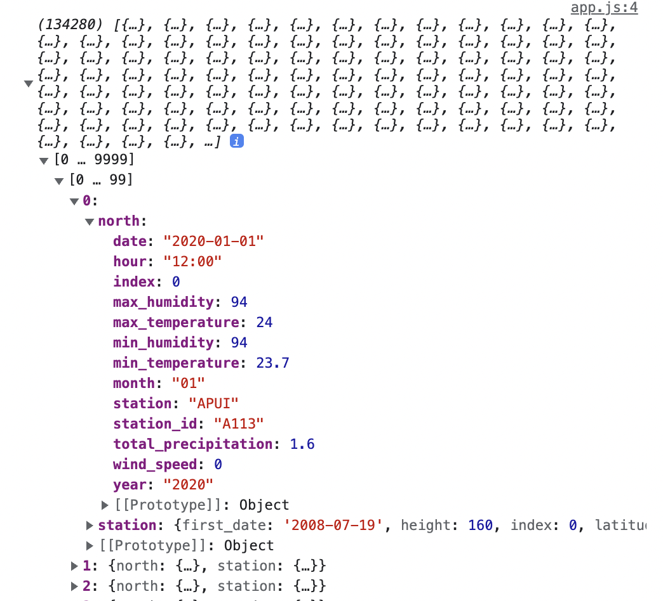
Creating Flask routes
One route connects the correct Station table row to the corresponding North table row

Slide 8
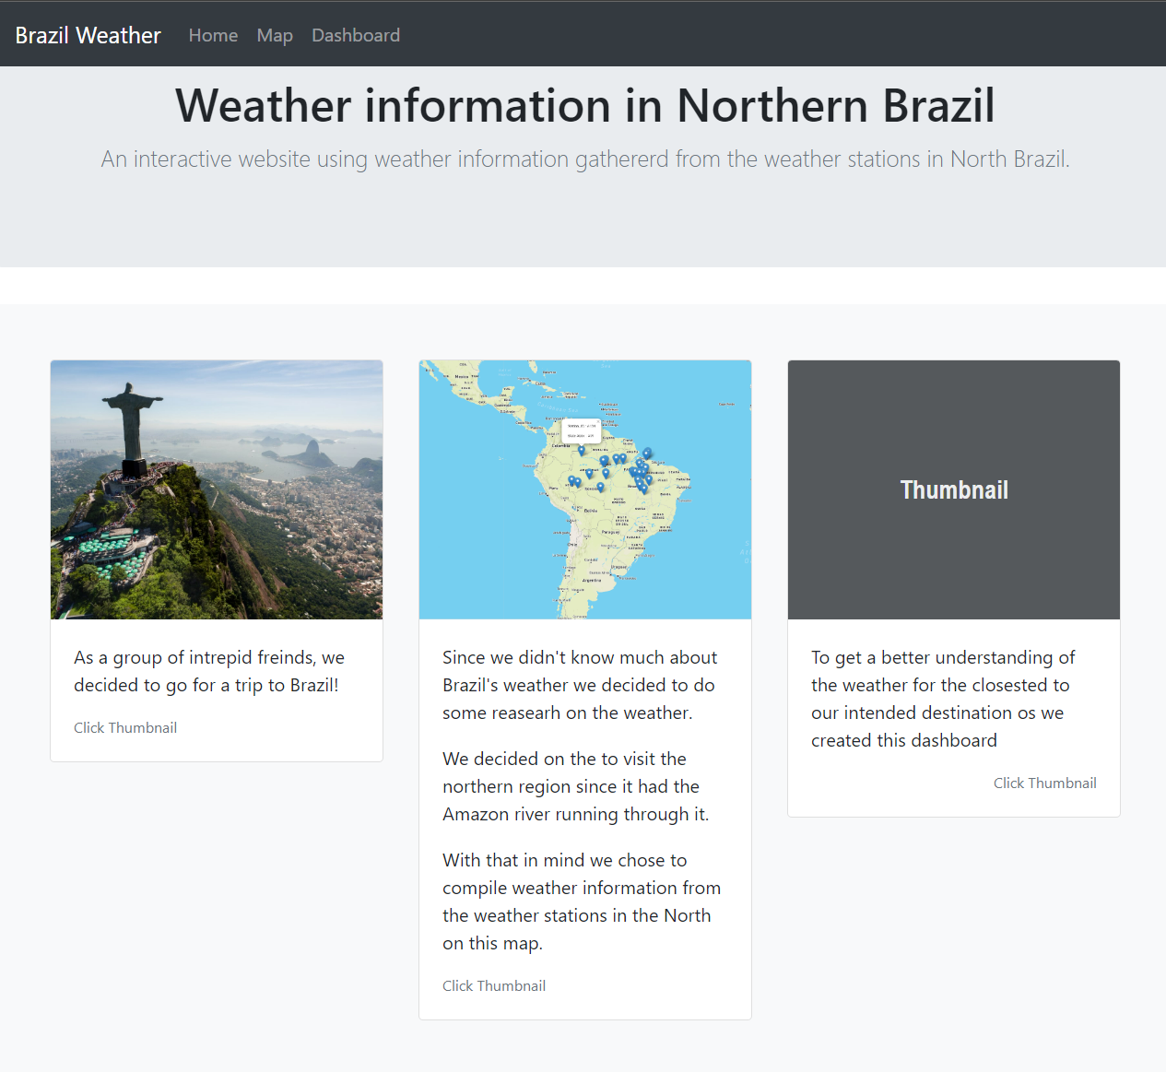
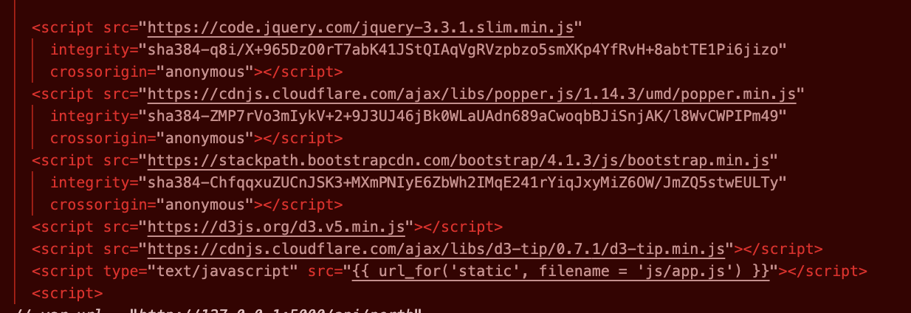
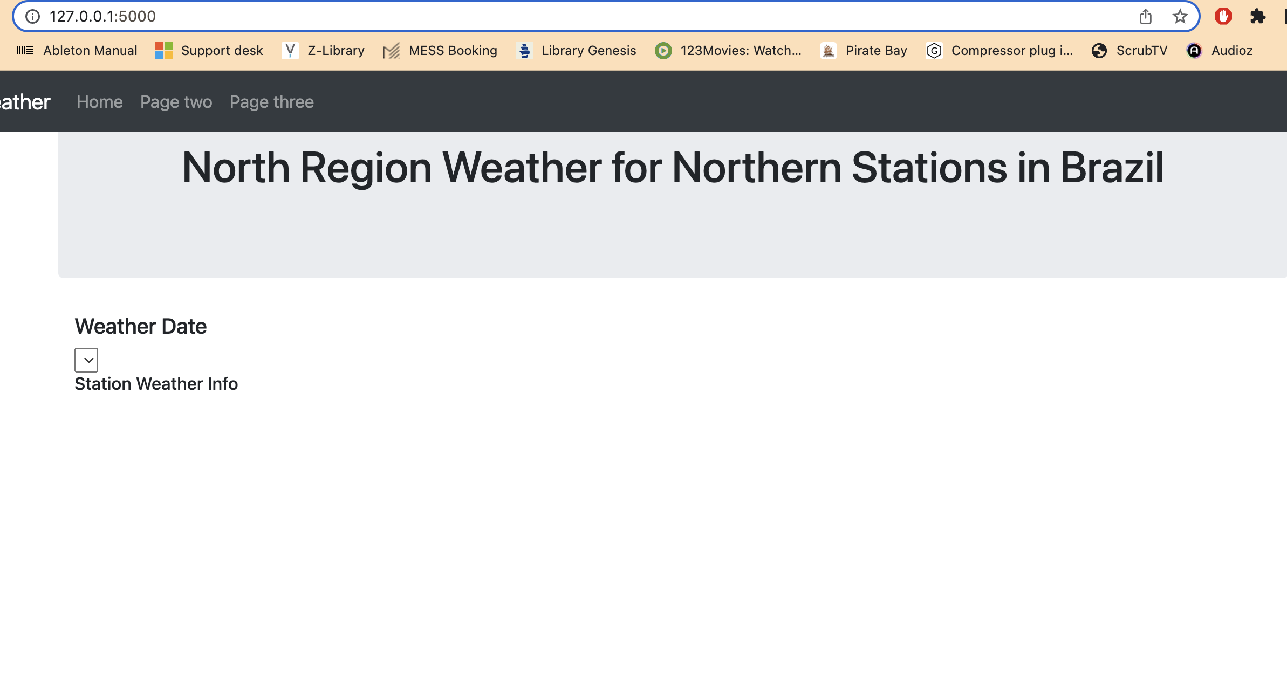
HTML
Dependencies: jquery, bootstrap, d3,

Slide 9
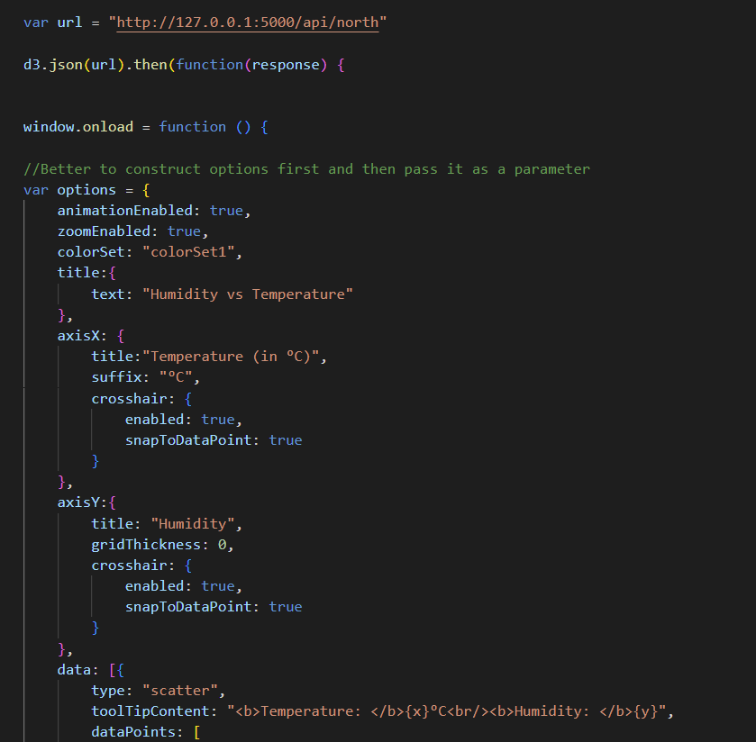
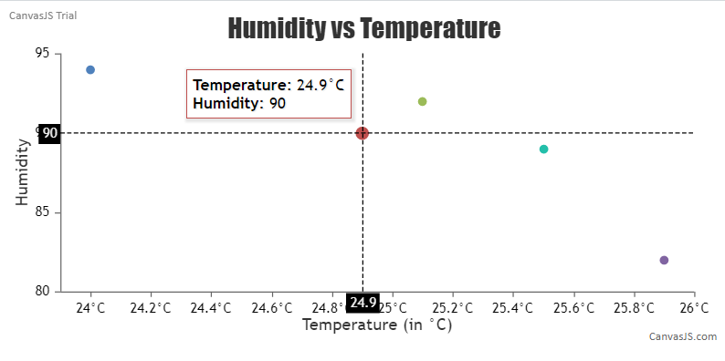
Next steps: Javascript plots
Using jQuery

Slide 10
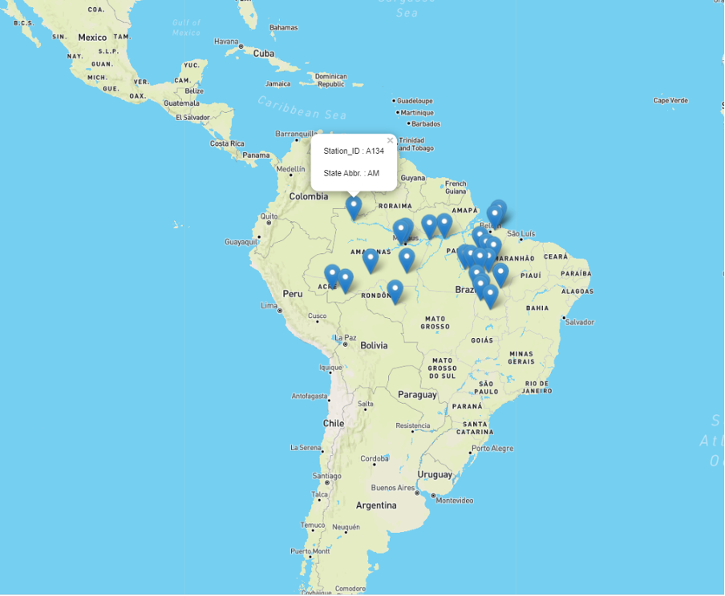
Next steps: Map

